Slide 1

FP_2 Presentation
Niklas Roberts, Zach Bowyer, Ben Greenwood, Brycen Martin, Garrett O’Shaughnessy

Slide 2
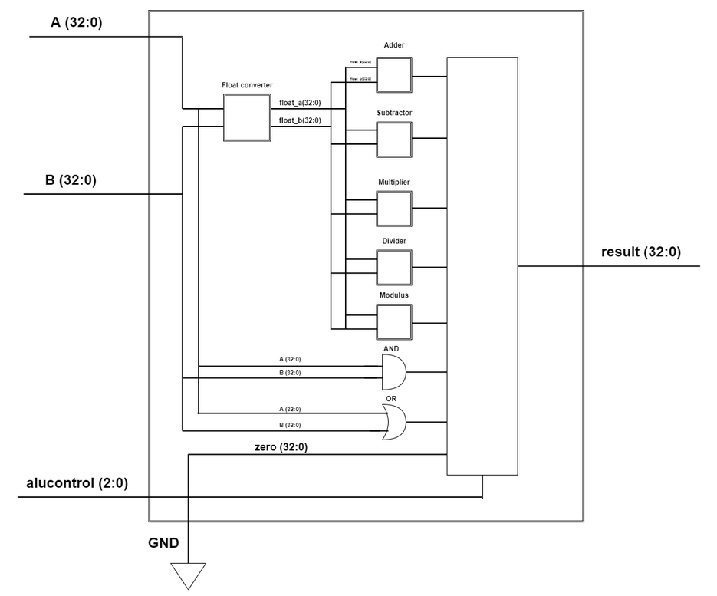
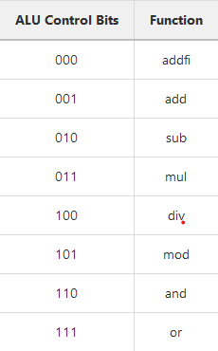
ALU Design

Slide 3
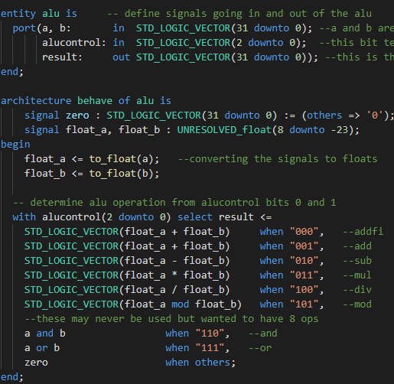
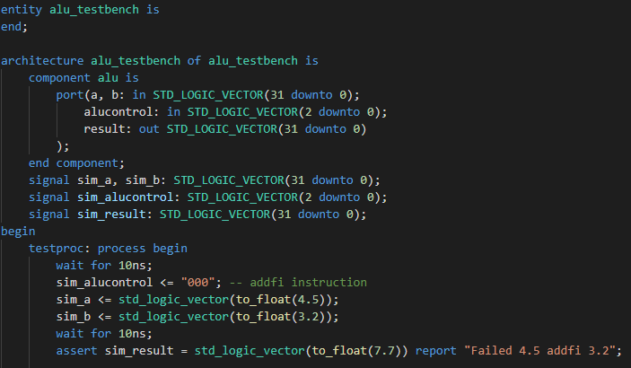
ALU Implementation

